Slide 1

Learning To Edit Code
Ph.D. Defense Presentation
Saikat Chakraborty
Department of Computer Science
Columbia University.
July 26, 2022
Committee
Dr. Gail Kaiser (Chair), Columbia University
Dr. Baishakhi Ray (Adviser), Columbia University
Dr. Kathleen McKeown, Columbia University
Dr. Junfeng Yang, Columbia University
Dr. Kai-Wei Chang, University of California at Los Angeles

Slide 2
Automatic Code Editing

Slide 3
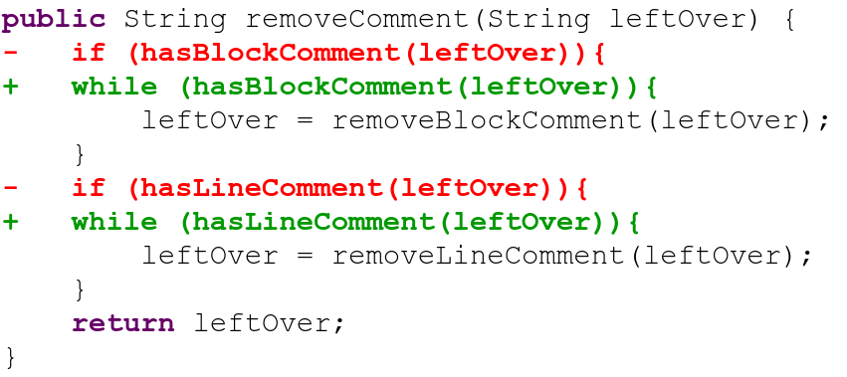
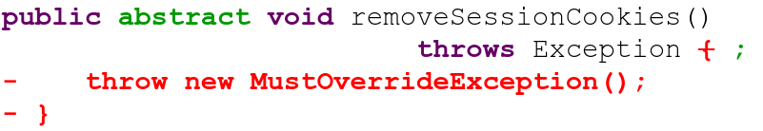
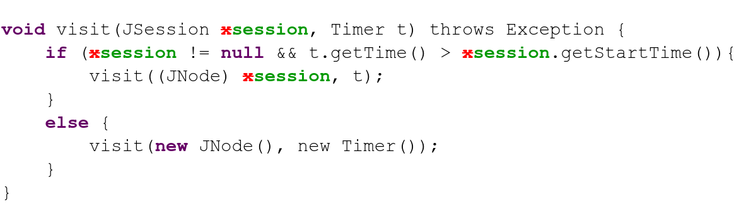
Adding Feature
Bug-fixing
Refactoring

Slide 4
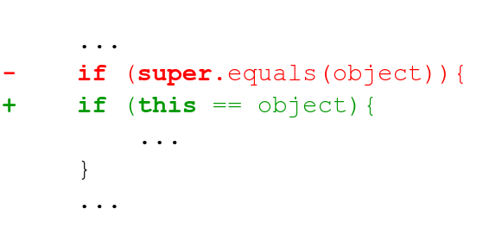
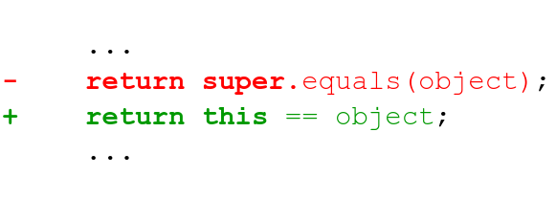
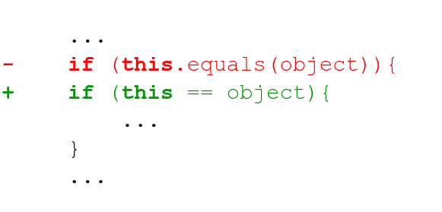
(Meng et. al. 2011[1], 2013[2], Ray et. al. 2015[3])
Code Edits Are Repetitive (Meng et. al. 2011[1], 2013[2], Ray et. al. 2015[3])
Is it possible to
Automate
Such Code Edits?

Slide 5
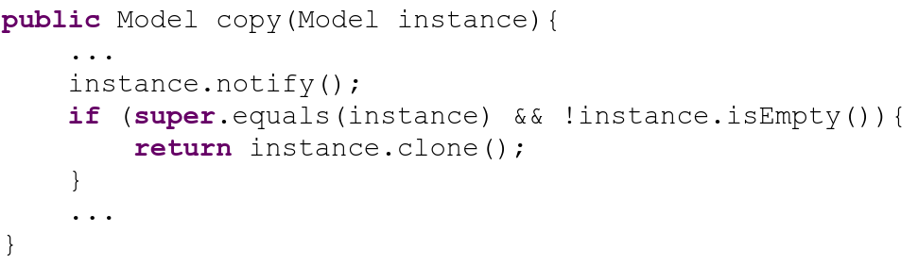
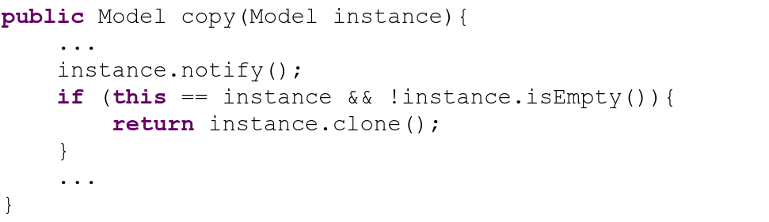
Automating Code Edits - Template/Search based
Edit Template
Match Found
Patch Applied
Too many templates to write (Saha et al.[22])

Slide 6
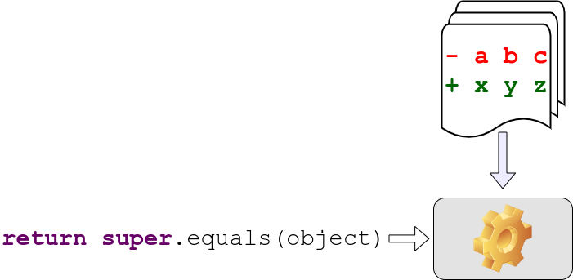
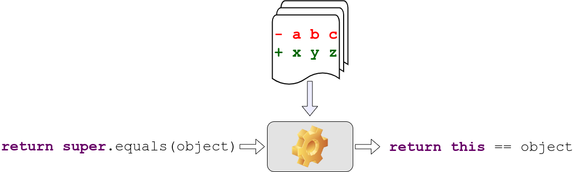
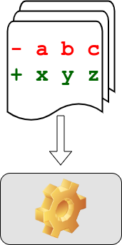

Code Editing Task - Learning Based Solution
Example Code Edits
Code Before Edit
Code After Edit

Slide 7
What are my Contributions?
Application in Automatic Program Repair and Other SE tasks.
3
Development of Models for Automated Code Editing.
2
Identification of Technical Challenges in Learning based Code Editing.
1

Slide 8
Automated Code Editing - Existing works.
Template-based
Modern IDE (Eclipse, IntelliJ IDEA) - Refactoring, Boilerplate Code.
Meng et.al. - PLDI’11 - Infer edit template with graph matching [1].
Mutation Learning
Rolim et. al. - ICSE’17 - Designed a DSL for representing Edits [4].
Dinella et.al. - ICLR’20 - Neural Turing Machine [5].
Encoder-Decoder
Tufano et. al. - ASE’18 [6], ICSE’19 [7], TOSEM’19 [8]. - Abstract tokenization.
Chen et. al. - TSE’19 - Copy Attention-based models [9].
Tufano et. al. - ICSE’21. - Multi-Encoder models[10].

Slide 9
Encoder-Decoder
Based Code Editing

Slide 10
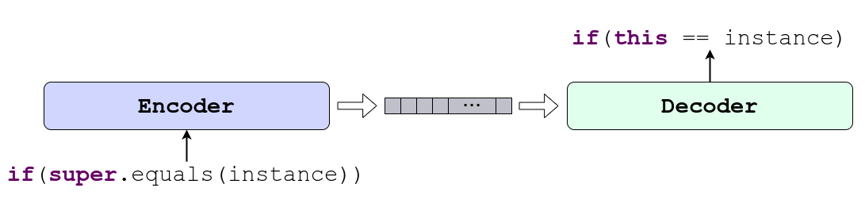
Code Editing with Encoder-Decoder
Encoder and Decoder learns Edit Pattern and
To Apply the Pattern in Similar Context.

Slide 11
Encoder-Decoder Based Code Editing
Where does my dissertation stand?

Slide 12



Method | Concrete Code | Syntactic Correctness | Contextual Correctness | Code Naturalness | Multi Modality
M. Tufano et. al. ASE 2018 [6], ICSE 2019 [7]
SequenceR - Chen et. al. TSE 2019 [9]
CODIT - TSE 2020
CodeBERT* - Feng et. al. EMNLP 2020 [11]
PLBART - NAACL 2021
CoCoNut - Lutellier et. al. ISSTA 2020 [12]
R. Tufano et. al. - ICSE 2021 [10]
MODIT – ASE 2021
NatGen – FSE 2022
Used/Guaranteed
Not Used
No guarantee
Empirical guarantee
* While CodeBERT is an encoder only pretrained model, it has been used for program repair with a transformer decoder trained from scratch.

Slide 13
Code Editing with Encoder-Decoder

Slide 14
Code Editing with Encoder-Decoder
Encoder encodes the input code to a vector or matrix.
Decoder generates the edited code.

Slide 15
Desired Properties of
Encoder and Decoder

Slide 16
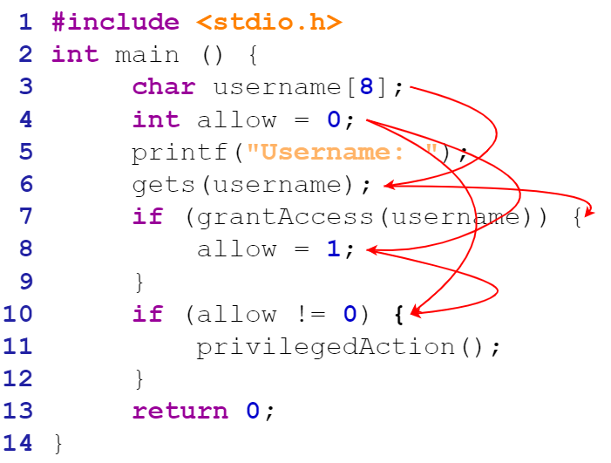
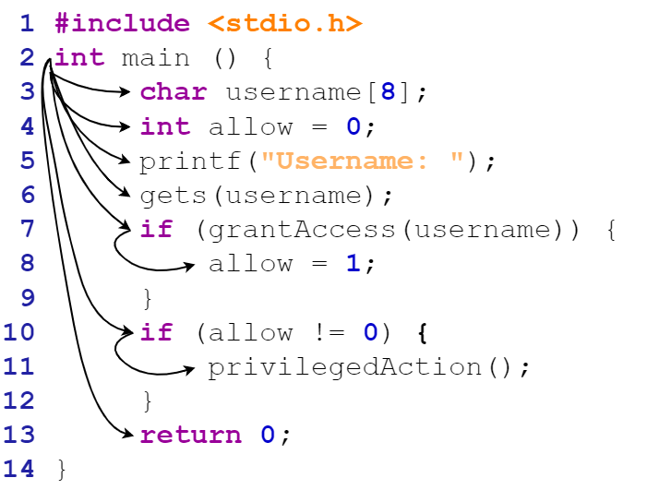
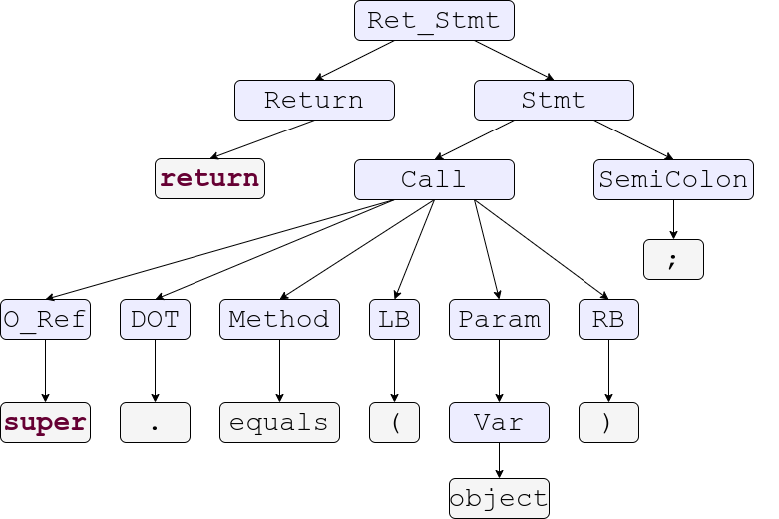
Properties of Source Code.
Control Dependency
Syntax Structure
Data Dependency
16

Slide 17
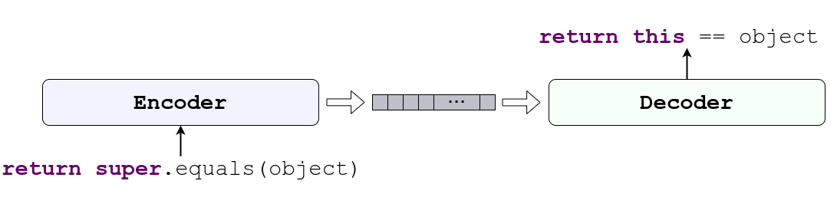
Desired Properties of the Encoder
Source Code
Encoder
Understand Structure
Understand Dependency

Slide 18
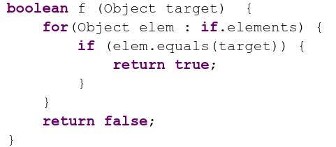
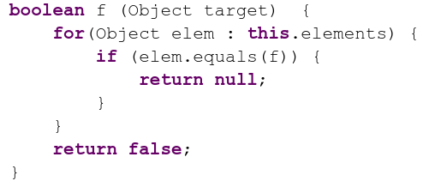
Desired Properties of the Decoder
Syntactic correctness.
Semantic correctness.
Decoder
Syntactically Incorrect
Semantically Incorrect

Slide 19
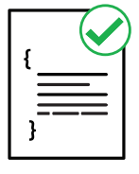


Code Editing as Understanding and Generation
Understanding
Source Code
Syntax
Understanding Structure
And Functionality of Source Code
Generating
Source Code
Encoding
Ensuring the Syntactic and Semantic Correctness for Generating Source Code
Semantics
19

Slide 20
Encoding PL Properties
Syntax
Code Modeling
Explicit Encoding
Implicit Encoding
Natural Channel Mutation
Formal Channel Mutation
Ways of Encoding
Semantics
20

Slide 21
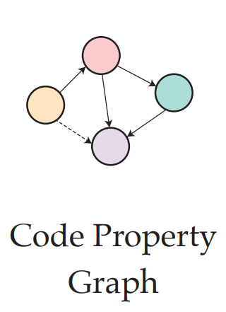
Explicit Encoding
Code Modeling
Explicit Encoding
Implicit Encoding
Natural Channel Mutation
Formal Channel Mutation
[13] Learning to Represent Program as Graphs
Allamanis et. al. 2017
[14] Learning to Represent Edits
Yin et. al. 2019
[5] HOPPITY – Dinella et. al. 2020
21

Slide 22
CODIT: Code Editing With Tree Based Neural Models
TSE - 2020
Findings
Generation of Syntax Tree instead of code Guarantees Syntactic Correctness.
Contribution
Tree/Grammar Based Model for Automatic Code Editing.

Slide 23
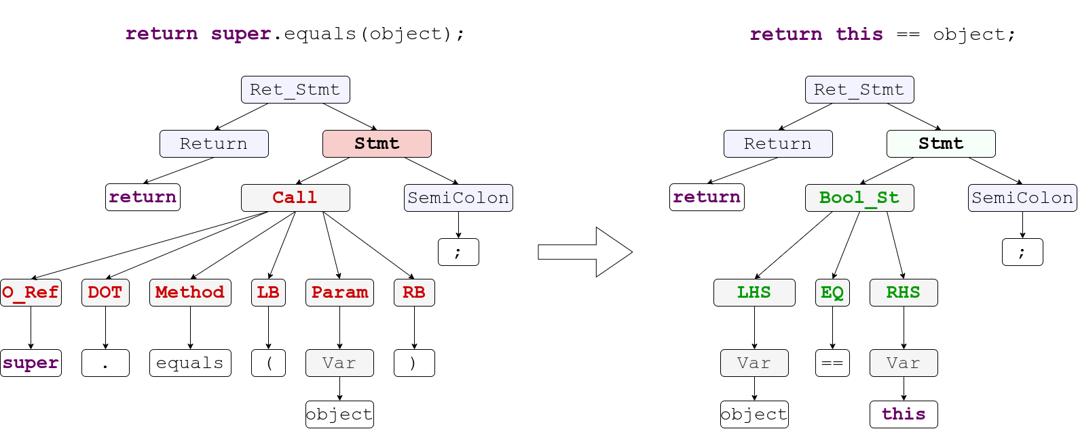
CODIT: Code Editing With Tree Based Neural Models
Code Before Edit
Code After Edit
23

Slide 24
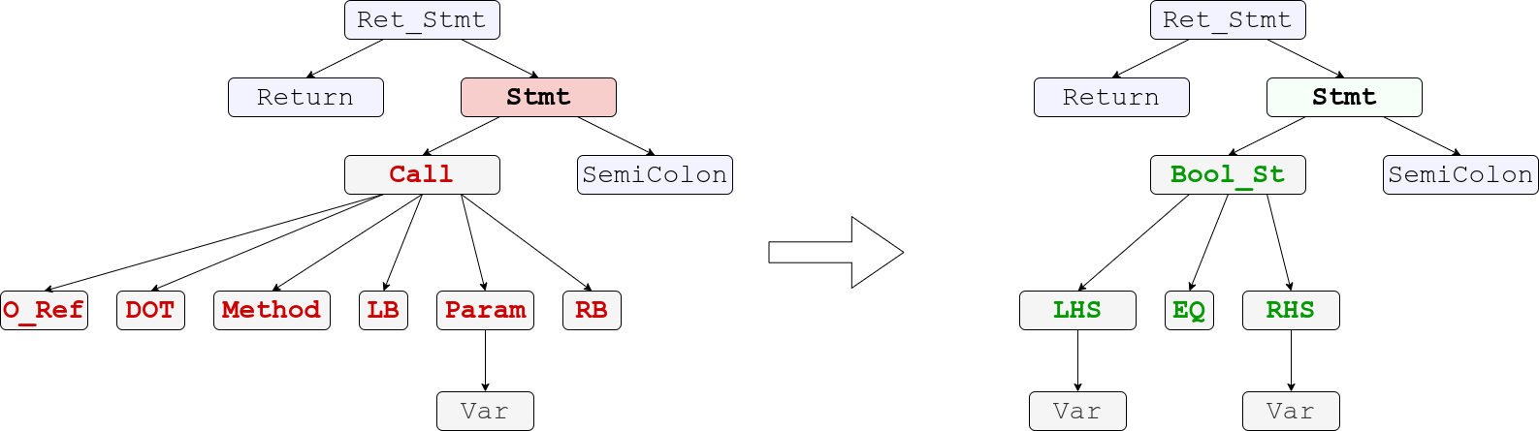
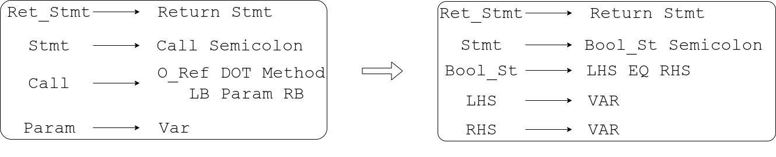
CODIT Step 1 : Tree Translation

Slide 25
CODIT Step 2 : Token Generation
Token Translation

Slide 26
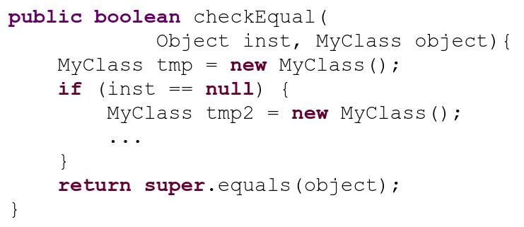
CODIT Step 2 : Token Generation
Reachable Variables in Edit Location:
{inst, object, tmp}
Reachability Analysis in Edit Location

Slide 27
CODIT
Evaluation

Slide 28
CODIT: Study Subjects
Data Set | Number of Projects | Number of Edit Examples | Code Fragment Size
 |  |  | Number of Tokens | Number of Nodes
Generic Code Edit from Github | 48 | 32,473 | Max - 38 Avg - 15 | Max - 47 Avg - 20
Pull Request Edits –Tufano et al. [7] | 3 | 5546 | Max - 34 Avg - 17 | Max - 47 Avg - 23

Slide 29
CODIT: Results (Accuracy in top 5)
Method |  | Generic Code Edits | Pull Request Edit
Sequence Based | LSTM-Seq2Seq | 3.77% | 11.26%
 | Tufano et. al. [7] | 6.57% | 23.65%
 | SequenceR [9] | 9.76% | 26.43%
Tree Based | Tree2Seq | 11.04% | 23.49%
 | CODIT | 15.94% | 28.87%

Slide 30
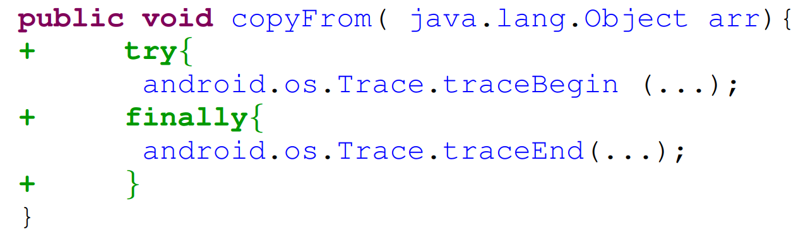
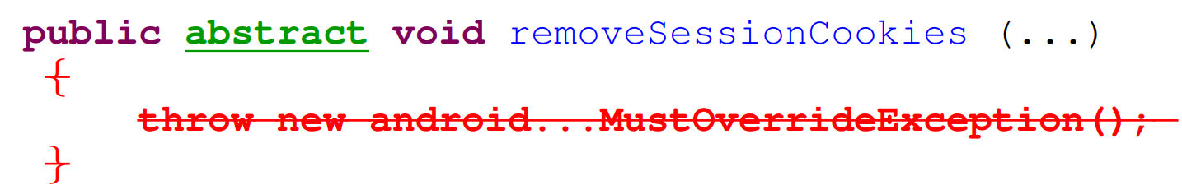
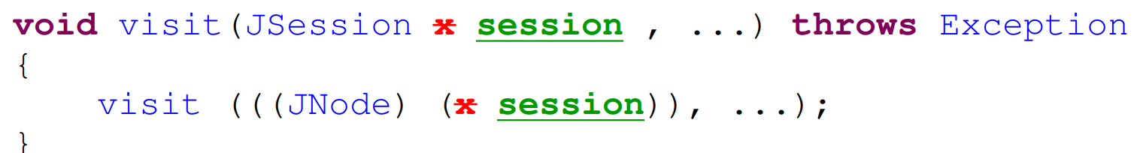
Example Edits
Addition
Deletion
Update

Slide 31
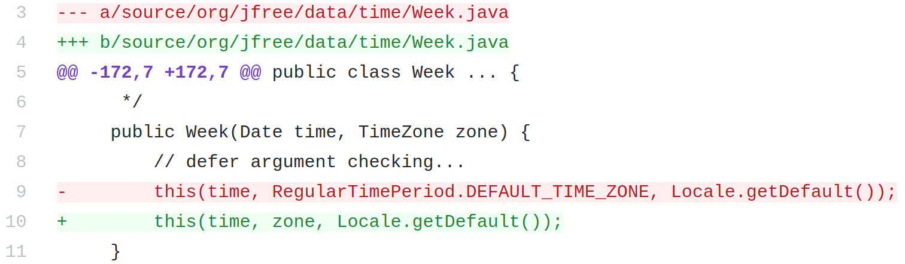
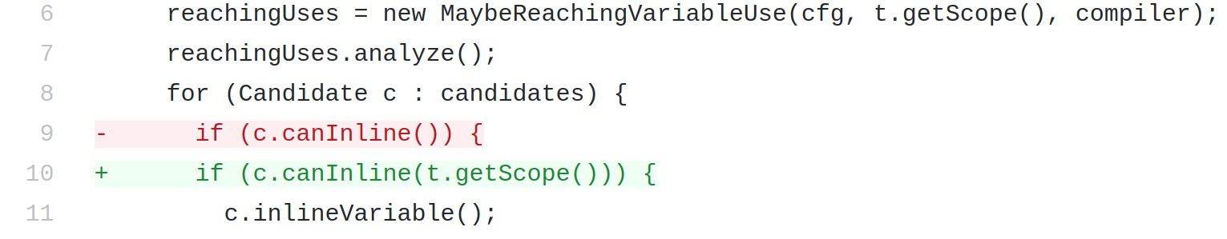
Application - Automatic Program repair
CODIT fixes 15 bugs completely and 10 bugs partially, out of 80 bugs in Defects4j.
JFreeChart: Bug-8
Closure Compiler: Bug-3

Slide 32
Explicit Encoding
Reachability Analysis
Context Free Grammar
32

Slide 33
Explicit Encoding – Take Away
Code Modeling
Explicit Encoding
Implicit Encoding
Natural Channel Mutation
Formal Channel Mutation
Pros
Precision
Guarantee
Cons
Model design overhead
Transferability
Explainable
Low Resource
33

Slide 34



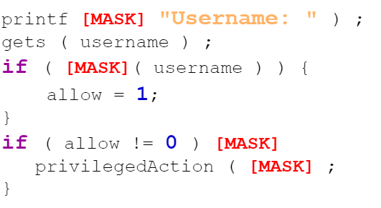
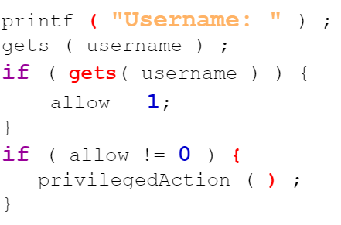
Implicit Encoding
Code Modeling
Explicit Encoding
Implicit Encoding
Natural Channel Mutation
Formal Channel Mutation
Large Data Corpus
Corrupted Input Code
Regenerated Correct Code
[11] CodeBERT – Feng et. al. 2019
[16] GraphCodeBERT – Guo et. al. 2020
[17] CodeX – Chen et. al. 2021
[18] CodeT5 – Wang et. al. 2021
34

Slide 35
Implicit Encoding - Pretraining
Hundreds of Gigabytes of source code
Large Models (Millions of Parameters)
Large numbers of unsupervised training steps
[17] CodeX – Chen et. al. 2021
[21] Github Copilot
[22] Amazon CodeWhisperer
35

Slide 36
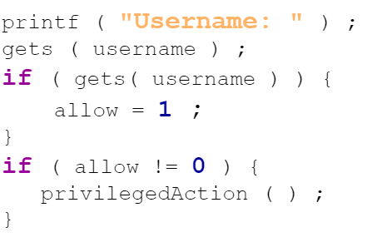
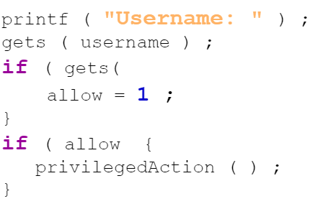


Implicit Encoding - Pretraining
Noise Injector
Correct Code
Noisy Code
Decoder
Encoder
Large Data Corpus
36

Slide 37



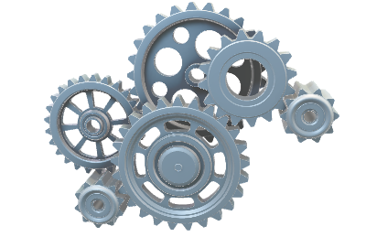
Implicit Encoding - Finetuning
Noise Injector
Correct Code
Noisy Code
Decoder
Encoder
Input (e.g. Code before edit, Context, etc.)
Output (e.g. Code after edit
Finetuning
37

Slide 38
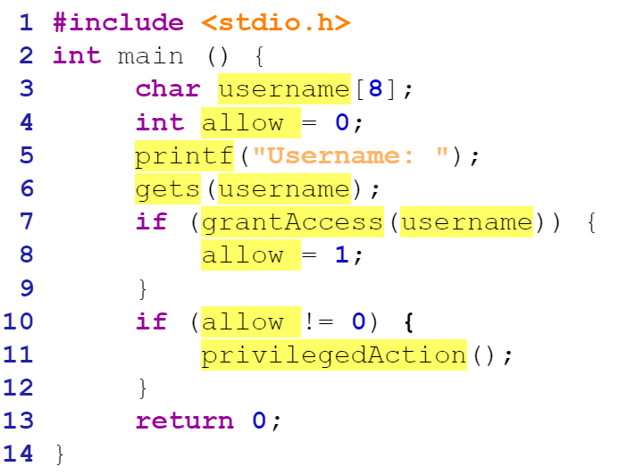
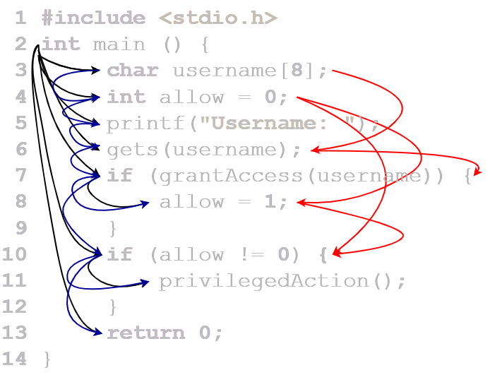
Noise Injectors & Dual Channel Hypothesis for Source Code [19]
Noise Injector
Correct Code
Noisy Code
[19] Casalanuovo et. al. 2020
[20] Karampatsis et. al. 2020
Natural Channel [19, 20]
Formal Channel
38

Slide 39
Natural Channel Mutation
Code Modeling
Explicit Encoding
Implicit Encoding
Natural Channel Mutation
Formal Channel Mutation
Mutator
39

Slide 40
Unified Pre-training for Program Understanding and Generation (PLBART)
NAACL - 2021
Findings
PL properties can be learned from large scale source- code dataset.
Contribution
Developed large scale pre-trained models for different SE tasks.

Slide 41
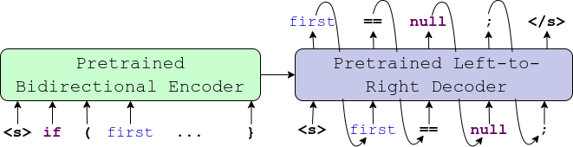
PLBART – What Is It?
Encoder
Decoder
Transformer Based Models
6 Encoder Layer, 6 Decoder Layer
12 attention heads

Slide 42
PLBART – Components
Read Code.
Understands Code.
Reason about any errors in code.
Learns robust representation
Encoder
Decoder
Generate Code.
Learns Coding Patterns.

Slide 43
PLBART – Pretraining
Noise Injector
Correct Code
Noisy Code
Decoder
Encoder
PLBART
Token Masking
Token Deletion
Token Infilling
43

Slide 44
PLBART – Jointly Learning to Understand and Generate
Token Masking
PLBART

Slide 45
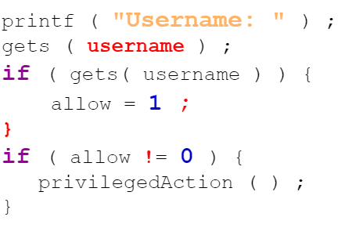
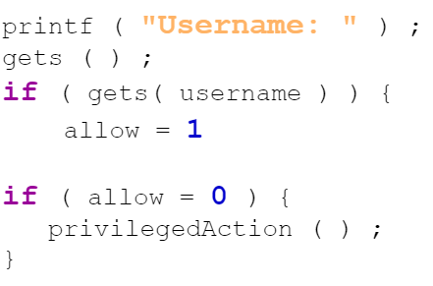
PLBART – Jointly Learning to Understand and Generate
Token Deletion
PLBART

Slide 46
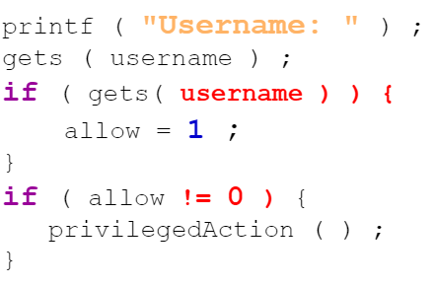
PLBART – Jointly Learning to Understand and Generate
Token Infilling
PLBART

Slide 47
PLBART – Pretraining
Noise Properties
Mutate Natural Channel
Likely to Break Syntax
Training Objectives
Generate the whole code.
Learns syntax implicitly
Learn Coding Patterns.
Multi-lingual Training
Java
Python
NL from Stack overflow
47

Slide 48
PLBART
Evaluation

Slide 49
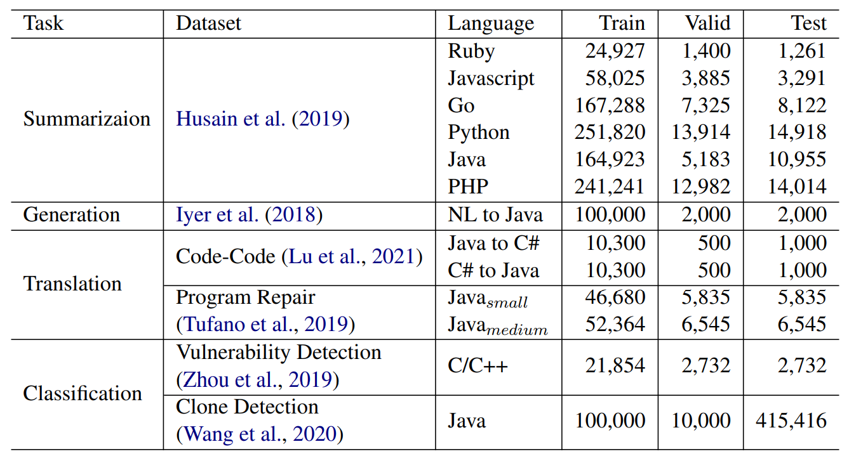
Downstream Tasks

Slide 50
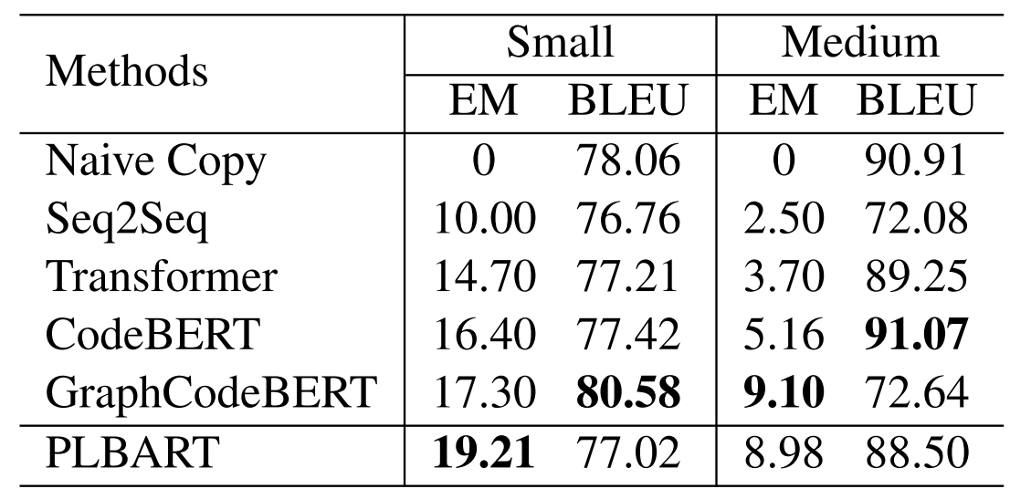
Code Editing (Program Repair) Result
Dataset: Bugfix dataset, Tufano et. al. 2019 [7] – Abstract Edit
Metric: EM (exact match) in Top-1 position
Small - Upto 50 Tokens
Medium - 51-100 tokens
Medium
Small
Medium

Slide 51
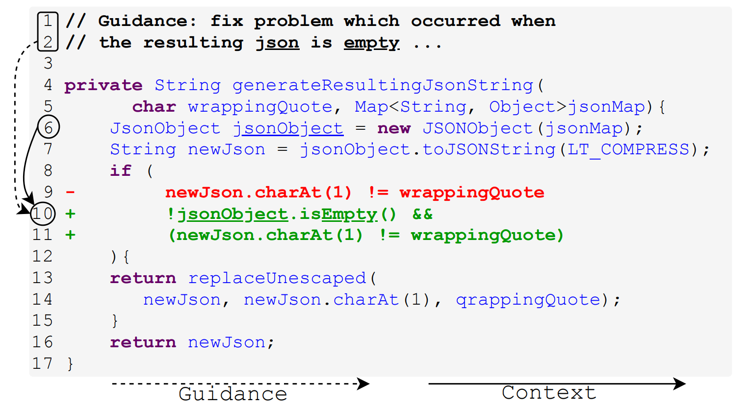

Developers Guidance
Context

Slide 52
MODIT : Multi-Modal Learning of Editing Source Code
ASE 2021
Findings
Developer Guidance and Context of Edit are very important for Automated Code Editing.
Contribution
Leveraging multiple information modalities to Automate Code editing, and identification of best way of processing such modalities.

Slide 53
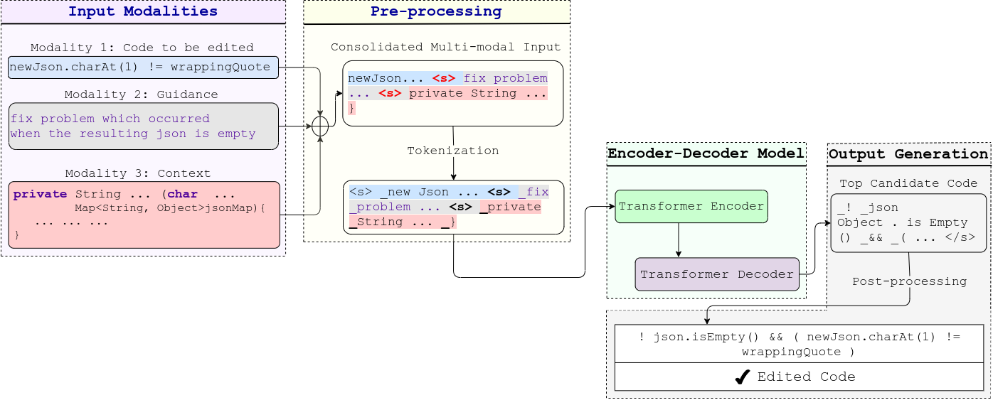
MODIT : Multi Modal Code Editing (pipeline)
PLBART

Slide 54
MODIT
Evaluation

Slide 55
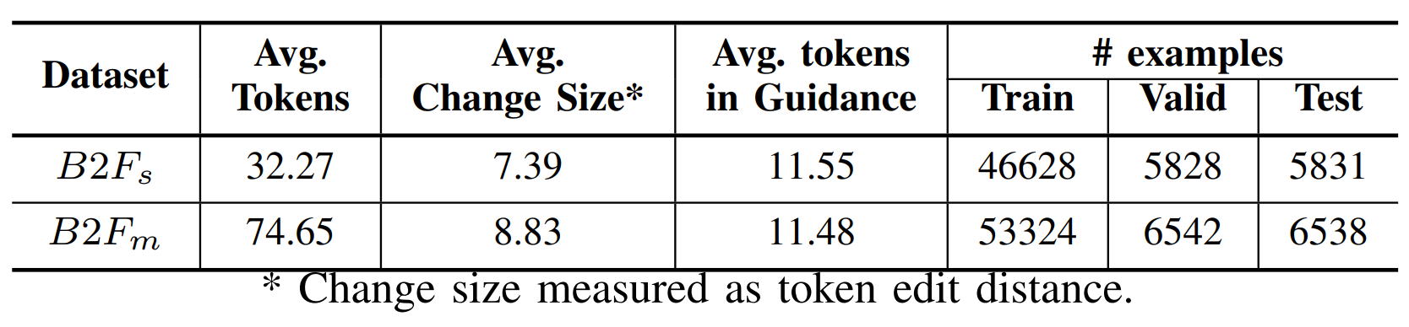
Experiments
Dataset (Tufano et. al. ICSE 2019 [7]) – Concrete Edits

Slide 56
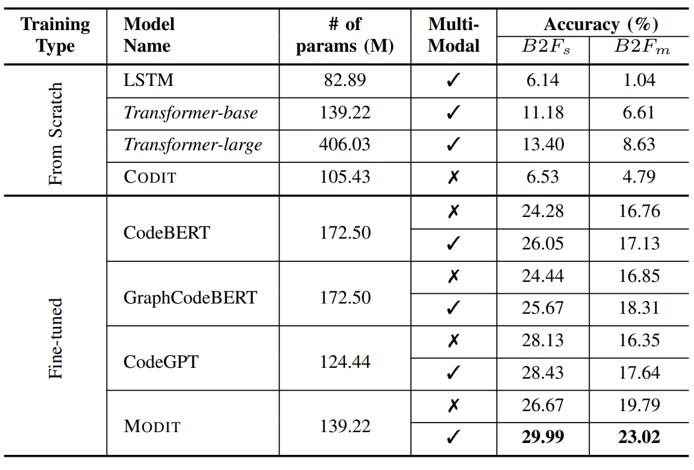
MODIT : Result
(PLBART)

Slide 57
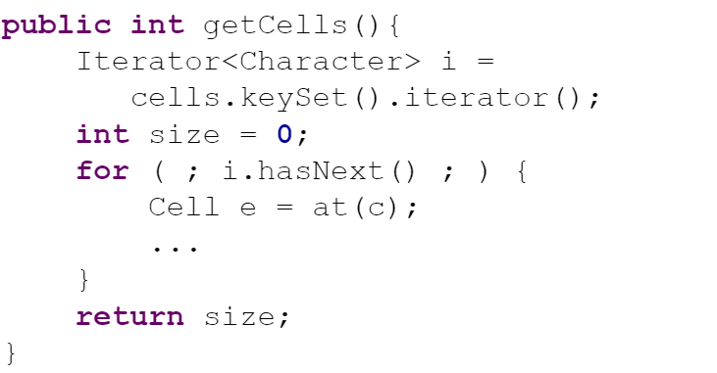
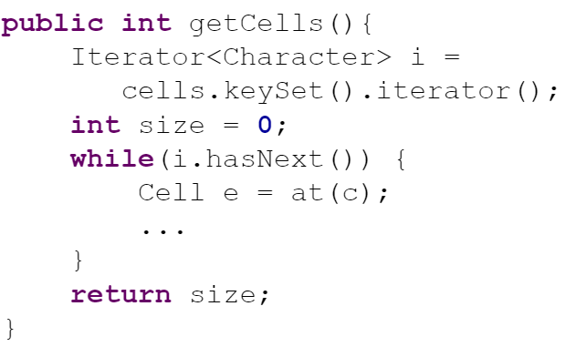
Interesting Code Generated by PLBART
PLBART generated
Better Code
57

Slide 58
Formal Channel Mutation
Code Modeling
Explicit Encoding
Implicit Encoding
Natural Channel Mutation
Formal Channel Mutation
Mutator
58

Slide 59
NatGen: Generative Pretraining by “Naturalizing” Source Code
FSE 2022
Findings
Forcing a model to edit unnatural code to re-write in a more natural way embeds developers’ natural way of writing code into the model.
Contribution
Designed a large-scale pretrained model which learned natural coding patterns from developers, with demonstrated higher performance in few shot code generation.

Slide 60
NatGen: Generative pre-training by “Naturalizing” source code
Write Semantic / Functional Equivalent Code in “More Natural” way
60

Slide 61
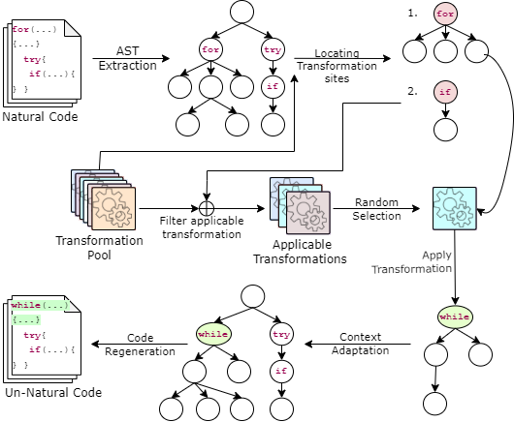
NatGen: Generative pre-training by “Naturalizing” source code
De-Naturalizing Transformation
61

Slide 62
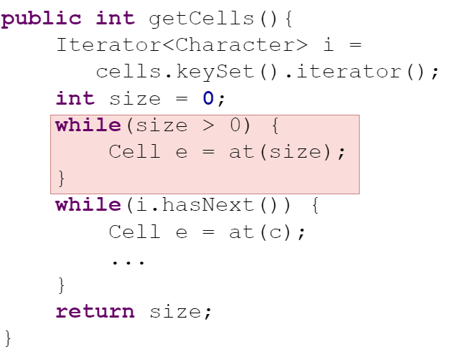


NatGen: De-Naturalizing Transformations
Confusing Statements [17]
Dead Code Insertion
Operand Swap
[21] Gopstein et. al. 2020
62

Slide 63


NatGen: Generative pre-training by “Naturalizing” source code
Encoder
Decoder
NatGen - Pretraining
NatGen – FineTuning for code Editing
63

Slide 64
NatGen
Evaluation

Slide 65

NatGen: Automated Code Editing Result
BugFix dataset proposed by Tufano et al. (ICSE 2019) [7]
Exact Match accuracy (%) at Top 1 generated edit.
65

Slide 66


NatGen: Automated Code Editing Result
Zero-Shot
Few-shot (200 training examples)

Slide 67

NatGen: Automated Code Editing Result
Number of Training Examples

Slide 68
Explicit Encoding – Take Aways
Pros
Little overhead
Cons
No Guarantee
Unsupervised
Transferable
Potential Bias from Mutation
Pretraining needs massive resource
Code Modeling
Explicit Encoding
Implicit Encoding
Natural Channel Mutation
Formal Channel Mutation
68

Slide 69

Dissertation Summary
Explicit Encoding
Encoder
Decoder
Syntax
Code Modeling
Explicit Encoding
Implicit Encoding
Natural Channel Mutation
Formal Channel Mutation
Implicit Encoding
Ways of Encoding
Semantics
Large Data Corpus
69

Slide 70
List of Publications
NatGen: Generative pre-training by" Naturalizing" source code - S Chakraborty, T Ahmed, Y Ding, P Devanbu, B Ray. The ACM Joint European Software Engineering Conference and Symposium on the Foundations of Software Engineering (ESEC/FSE 2022).
Towards Learning (Dis)-Similarity of Source Code from Program Contrasts - Y Ding, L Buratti, S Pujar, A Morari, B Ray, S Chakraborty Proceedings of the 60th Annual Meeting of the Association for Computational Linguistics (ACL’22).
On Multi-Modal Learning of Editing Source Code - S Chakraborty, B Ray 2021 36th IEEE/ACM International Conference on Automated Software Engineering (ASE’21).
Retrieval Augmented Code Generation and Summarization - MR Parvez, WU Ahmad, S Chakraborty, B Ray, KW Chang Findings of the Association for Computational Linguistics 2021 (ENMLP).
Deep learning-based vulnerability detection: Are we there yet? - S Chakraborty, R Krishna, Y Ding, B Ray IEEE Transactions on Software Engineering (TSE’21).
Unified Pre-training for Program Understanding and Generation - WU Ahmad, S Chakraborty, B Ray, KW Chang Annual Conference of the North American Chapter of the Association for Computational Linguistics (NAACL’21).
CODIT: Code editing with tree-based neural models - S Chakraborty, Y Ding, M Allamanis, B Ray IEEE Transactions on Software Engineering (TSE’20).
A transformer-based Approach for Source Code Summarization - W Ahmad, S Chakraborty, B Ray, KW Chang Association for Computational Linguistics (ACL’20).
Toward optimal selection of information retrieval models for software engineering tasks - MM Rahman, S Chakraborty, G Kaiser, B Ray 2019 19th International Working Conference on Source Code Analysis and Maintenance (SCAM’19).
Building language models for text with named entities - MR Parvez, S Chakraborty, B Ray, KW Chang 56th Annual Meeting of the Association for Computational Linguistics (ACL’18).
Which similarity metric to use for software documents? A study on information retrieval-based software engineering tasks - MM Rahman, S Chakraborty, B Ray Proceedings of the 40th International Conference on Software Engineering (ICSE’18).
70

Slide 71





My Research Applications
Programming Language Processing
Code Summarization
NeuralCodeSum (ACL’20), PLBART (NAACL’21)
Vulnerability Detection
ReVeal(TSE’21), BOOST(ACL’22)
Code Editing
CODIT (TSE’20), MODIT(ASE’21), DiffBERT (Facebook), NatGen(FSE’22)
PLP
Code Generation
PLBART (NAACL’21), DataTypeLM ForCode (ACL’18) NatGen (FSE’22)
Code Search and Synthesis
RedCoder (EMNLP’21), CodePanda (W.I.P)
71

Slide 72





Future Plan (Short Term Goal)
API driven Program Synthesis
Improving Semantic Code Search with RL
Synthesizer
I/O Similarity
72

Slide 73


Future Plan (Short Term Goal)
Learning Code Syntax and Semantics with Reinforcement Learning (RL)
Representing Code Context as Dynamic Graph
73

Slide 74






Future Plan (Long Term Goal)
Code Generation
Formal Analysis
Probabilistic models
Guarantee for the Analysis
Scalable and Transferrable
Noise Intolerant
No theoretical Guarantee
Developer Feedback Oriented Automation
74

Slide 75











Baishakhi Ray
Adviser
Wasi Ahmad
UCLA / Amazon
Miltos Allanmanis
MSR
Kai-Wei Chang
UCLA
Prem Devanbu
UC Davis
Yangruibo Ding
Columbia
Gail Kaiser
Columbia University
Rahul Krishna
Columbia / IBM
Toufiq Parag
UC Davis
Rizwan Parvez
UCLA
Masudur Rahman
Uva/Purdue
75

Slide 76
References
[1] Meng, Na, Miryung Kim, and Kathryn S. McKinley. "Systematic editing: generating program transformations from an example." ACM SIGPLAN Notices 46.6 (2011): 329-342.
[2] Meng, Na, Miryung Kim, and Kathryn S. McKinley. "LASE: locating and applying systematic edits by learning from examples." 2013 35th International Conference on Software Engineering (ICSE). IEEE, 2013.
[3] Ray, Baishakhi, et al. "The uniqueness of changes: Characteristics and applications." 2015 IEEE/ACM 12th Working Conference on Mining Software Repositories. IEEE, 2015.
[4] Rolim, Reudismam, et al. "Learning syntactic program transformations from examples." 2017 IEEE/ACM 39th International Conference on Software Engineering (ICSE). IEEE, 2017.
[5] Dinella, Elizabeth, et al. "Hoppity: Learning graph transformations to detect and fix bugs in programs." International Conference on Learning Representations (ICLR). 2020.
[6] Tufano, Michele, et al. "An empirical investigation into learning bug-fixing patches in the wild via neural machine translation." Proceedings of the 33rd ACM/IEEE International Conference on Automated Software Engineering. 2018.
[7] Tufano, Michele, et al. "On learning meaningful code changes via neural machine translation." 2019 IEEE/ACM 41st International Conference on Software Engineering (ICSE). IEEE, 2019.
[8] Tufano, Michele, et al. "An empirical study on learning bug-fixing patches in the wild via neural machine translation." ACM Transactions on Software Engineering and Methodology (TOSEM) 28.4 (2019): 1-29.
[9] Chen, Zimin, et al. "Sequencer: Sequence-to-sequence learning for end-to-end program repair." IEEE Transactions on Software Engineering 47.9 (2019): 1943-1959.
[10] Tufano, Rosalia, et al. "Towards automating code review activities." 2021 IEEE/ACM 43rd International Conference on Software Engineering (ICSE). IEEE, 2021.
[11] Feng, Zhangyin, et al. "CodeBERT: A Pre-Trained Model for Programming and Natural Languages." Findings of the Association for Computational Linguistics: EMNLP 2020. 2020.
76

Slide 77
References
[12] Lutellier, Thibaud, et al. "Coconut: combining context-aware neural translation models using ensemble for program repair." Proceedings of the 29th ACM SIGSOFT international symposium on software testing and analysis. 2020.
[13] Allamanis, Miltiadis, Marc Brockschmidt, and Mahmoud Khademi. "Learning to Represent Programs with Graphs." International Conference on Learning Representations. 2018.
[14] Yin, Pengcheng, et al. "Learning to Represent Edits." International Conference on Learning Representations. 2018.
[15] Zhou, Yaqin, et al. "Devign: Effective vulnerability identification by learning comprehensive program semantics via graph neural networks." Advances in neural information processing systems 32 (2019).
[16] Guo, Daya, et al. "GraphCodeBERT: Pre-training Code Representations with Data Flow." International Conference on Learning Representations. 2020.
[17] Chen, Mark, et al. "Evaluating Large Language Models Trained on Code." (2021).
[18] Wang, Yue, et al. "CodeT5: Identifier-aware Unified Pre-trained Encoder-Decoder Models for Code Understanding and Generation." Proceedings of the 2021 Conference on Empirical Methods in Natural Language Processing. 2021.
[19] Casalnuovo, Casey, et al. "A theory of dual channel constraints." 2020 IEEE/ACM 42nd International Conference on Software Engineering: New Ideas and Emerging Results (ICSE-NIER). IEEE, 2020.
[20] Karampatsis, Rafael-Michael, et al. "Big code!= big vocabulary: Open-vocabulary models for source code." 2020 IEEE/ACM 42nd International Conference on Software Engineering (ICSE). IEEE, 2020.
[21] Gopstein, Dan, et al. "Thinking aloud about confusing code: A qualitative investigation of program comprehension and atoms of confusion." Proceedings of the 28th ACM Joint Meeting on European Software Engineering Conference and Symposium on the Foundations of Software Engineering. 2020.
[22] Saha, Ripon K., et al. "Elixir: Effective object-oriented program repair." 2017 32nd IEEE/ACM International Conference on Automated Software Engineering (ASE). IEEE, 2017.
77

Slide 78
Thanks!
78

Slide 79
Backup Slides

Slide 80
CODIT Step 1 : Tree Translation
80

Slide 81




CODIT Step 1 : Tree Translation
81

Slide 82
CODIT Step 1 : Tree Translation
Rules sequence of
Syntax Tree before edit
Rules sequence of
Syntax Tree after edit
82

Slide 83





CODIT Step 1 : Tree Translation
83

Slide 84
ReVeal: Program Understanding through Explicit Program Encoding
TSE - 2021
Findings
Graph-based models are better equipped to understand semantic relationships between code components
Contribution
Designed Code Understanding Framework using Graph-Based Models.

Slide 85






ReVeal : Explicit Encoding for Program Understanding
Training Data
Node Features
GGNN
Code Property Graph
Trained ReVeal
Graph Embedding

Slide 86


ReVeal : Explicit Encoding for Program Understanding
ReVeal
F1 score
Token
Based
Graph
Based
[15]
Token
Based
Graph
Based [15]
Chromium & Debian
FFMpeg & Qemu
[15] Devign Zhou et. al. 2019

Slide 87





Explicit Encoding PL knowledge into model
Code Property Graph
87

Slide 88

PLBART Results
Code Summarization

Slide 89

PLBART Results
Code Generation from Natural Language

Slide 90

PLBART Results
Code Translation

Slide 91

PLBART Results
Code Classification - % Accuracy for Vulnerability, F1 score for Clone Detection.

Slide 92

Code Translation Example

Slide 93




Slide 94


Slide 95


Slide 96


Slide 97

Transformers can learn syntax

Slide 98
Pretrained models improves Code editing

Slide 99
Multi Modality Improves Code Editing

Slide 100

Impact of Different Information Modality.

Slide 101

Impact of Different Information Modality.
Impact of Guidance

Slide 102

Impact of Different Information Modality.
Impact of Context

Slide 103

Best way to encode input Modalities.
R. Tufano et. al. - ICSE 2021

Slide 104

Best way to encode input Modalities.

Slide 105


Best way to encode input Modalities.

Slide 106




NatGen: Code Generation By Pretrained Models
Model | Syntax Match (%) | Dataflow Match (%) | CodeBLEU (%) | Direct Copy (%) | Avg. Edit Distance
CodeT5[18] | 13.83 | 23.67 | 10.87 | 0 | 65
PLBART | 73.17 | 75.95 | 74.56 | 7.05 | 3
NatGen | 98.16 | 96.85 | 96.82 | 0.01 | 10
[18] Wang et al. 2021
106

Slide 107

NatGen Results
NL to Code Generation

Slide 108

NatGen Results
Code Translations

Slide 109

NatGen Results
Code Summarization

Slide 110

NatGen Results
Zero Shot Learning

Slide 111

NatGen Results
Few Shot Learning

Slide 112

NatGen Results
Few Shot - Ablation

Slide 113

NatGen Results
Few Shot - Ablation

Slide 114

Code Before Edit
Code After Edit
Language Model
Edit Model
Language Model

Slide 115
Pretraining - Embed the knowledge of input and output into the model.

Slide 116
PLBART - Pretraining both encoder and decoder.
Encoder
Decoder
What Type of Model should we use?

Slide 117


Recurrent Model Vs. Transformer Model
Recurrent Model
2. Transformer Model
T4

Slide 118







Slide 119

BERT - Pretrained Transformer Encoder
Pre-training:
Task agnostic Masked Language Model.
CuBERT - Kanade et. al. 2020.
CodeBERT - Feng et. al. 2020.
GraphCodeBERT - Guo et. al. 2021
SE usage: Better Suitable for Understanding Code.

Slide 120

Knowledge about generation is not embedded in Decoder.

Slide 121



CodeBERT vs. CodeGPT vs. PLBART
BERT
GPT
PLBART

